Slide 1
Cards and multi
rows cards
Cards and multi rows cards

Slide 2
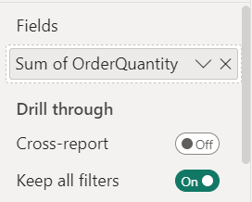
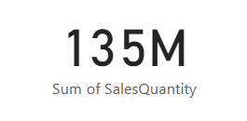
Cards and Multi-Row Cards
Note: This lab uses Sales.xls file the Excel Sources folder
Add Card From visualization panel
Add SalesQuantity of FactSales ​

Slide 3
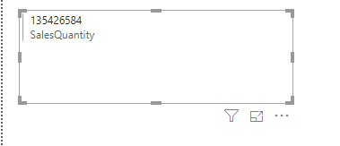
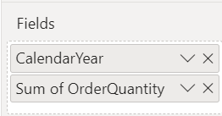
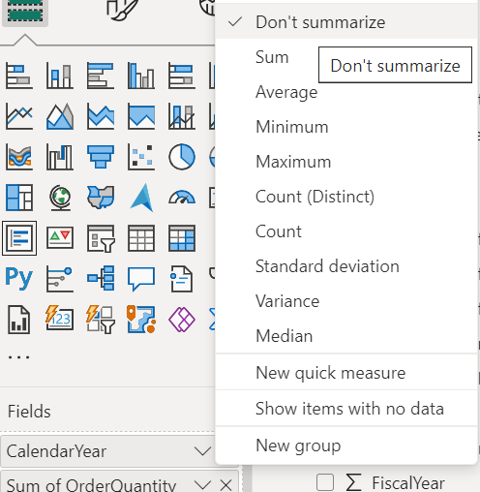
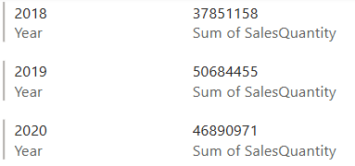
The cards
Change the visualization to MultirowCard on stage now
Add Year from DimDate and disable the summary on it

Slide 4
Thank you
Thank you

